Slide 1
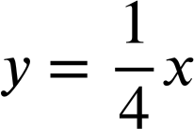
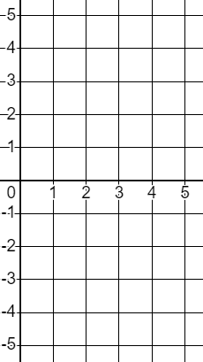
Features of linear relationships
Task A: The constant rate of change
1) Classify these relationships into linear and non-linear.
y = 0.4x
Linear
Non-linear
y = x^{0.4}
y = 4x²
y = x + 4
y = 4x
4y = x
y = 2x⁴
y⁴ = x + 4
x + y = 4
y = x⁴ + 4
2) Complete the table for the given range of x values. Plot the relationships and show on the graph their constant rate of change.
a)
y = 2x − 5
x | 1 | 2 | 3 | 4 | 5
y
y
x
b)
y = 3 − x
y
x | 1 | 2 | 3 | 4 | 5
y
x

Slide 2
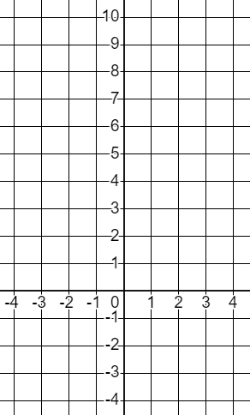
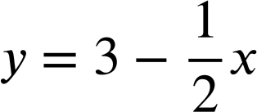
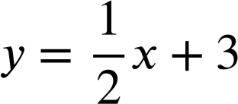
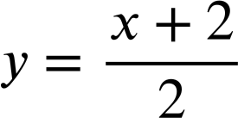
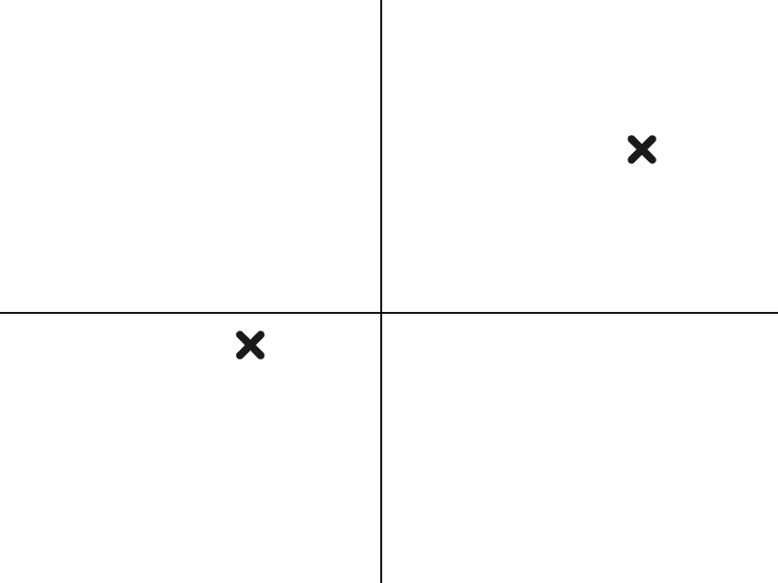
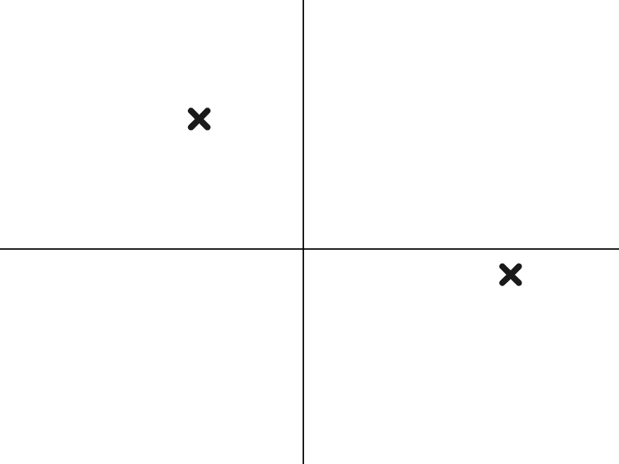
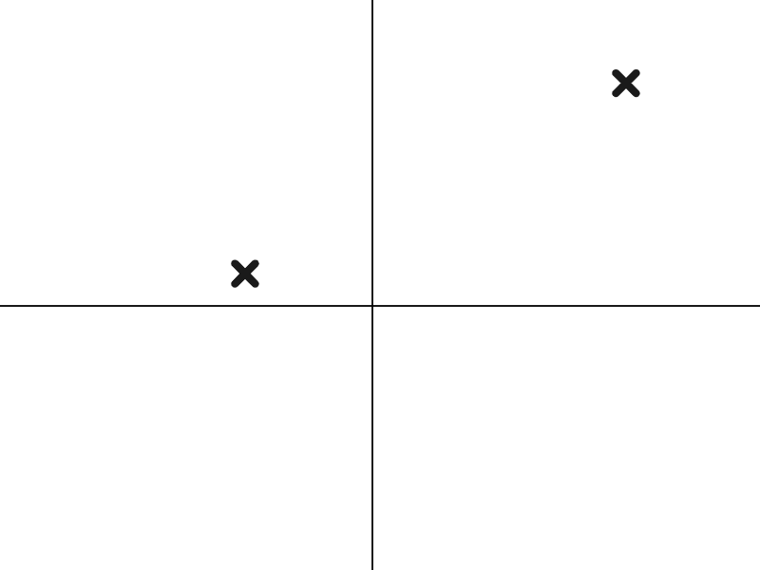
Features of linear relationships
3) This set of coordinates has a linear relationship with a constant rate of change.
Find the missing values, plot the graph, and show the constant rate of change.
y
x | −4 | −2 | 0 | 2 | 4
y | −3 |  |  |  | 9
x
Task B: Graphical and algebraic representations
1) Match the coordinate pairs to their respective relationships and graphs.
A (−4, 1) and (8, 7)
B (−4, 5) and (8,−1)
C (−4,−1) and (8, 5)
D
E
F
G
H
I
Mathematics in Education and Industry
v2.2

